Slide 1
Digital Portfolio
STUDENT NAME: Befina jolas. J
REGISTER NO AND NMID: BRU312428A0001/as2428a0001
DEPARTMENT: B.Sc Digital and Cyber Forensic Science
COLLEGE: Cheran Arts Science College

Slide 2
PROJECT TITLE
Focus Timer- A Pomodoro Productivity Tool
Notes:
Focus Timer-A Pomodoro Productivity Tool
9618

Slide 3


AGENDA
Problem Statement
Project Overview
End Users
Tools and Technologies
Portfolio design and Layout
Features and Functionality
Results and Screenshots
Conclusion
Github Link
3/21/2024 Annual Review

Slide 4

PROBLEM STATEMENT
In today’s digital age, distractions are everywhere. Students and professionals often struggle to maintain focus during work or study sessions. The Pomodoro Technique offers a structured way to improve concentration and productivity.

Slide 5

PROJECT OVERVIEW
Focus Timer is a web-based application that helps users manage their time using 25-minute focus intervals followed by short breaks. It’s designed to be simple, intuitive, and effective for boosting productivity.

Slide 6

WHO ARE THE END USERS?
Students preparing for exams
Professionals working remotely
Anyone seeking better time management

Slide 7

TOOLS AND TECHNIQUES
HTML: Structure and layout
CSS: Styling and responsiveness
JavaScript: Timer logic and interactivity

Slide 8
POTFOLIO DESIGN AND LAYOUT
Clean, centered layout using Flexbox
Calming color palette for focus
Responsive design for desktop and mobile
Dynamic status messages for user feedback
8

Slide 9
FEATURES AND FUNCTIONALITY
⏱️ 25-minute countdown timer
▶️ Start, Pause, and Reset buttons
📣 Real-time status updates
💡 Easy to customize session durations

Slide 10
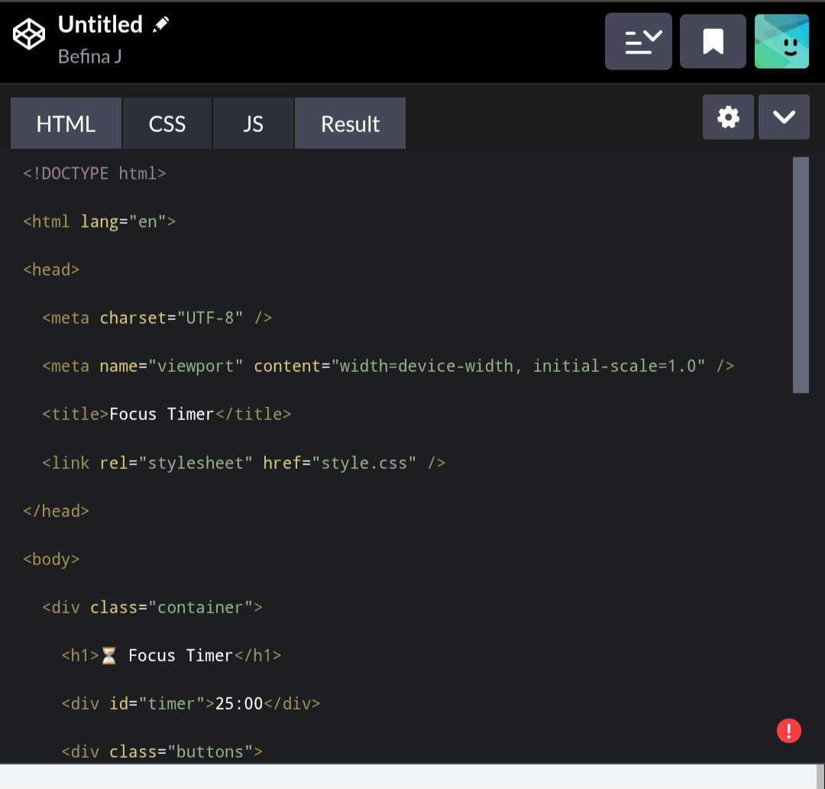
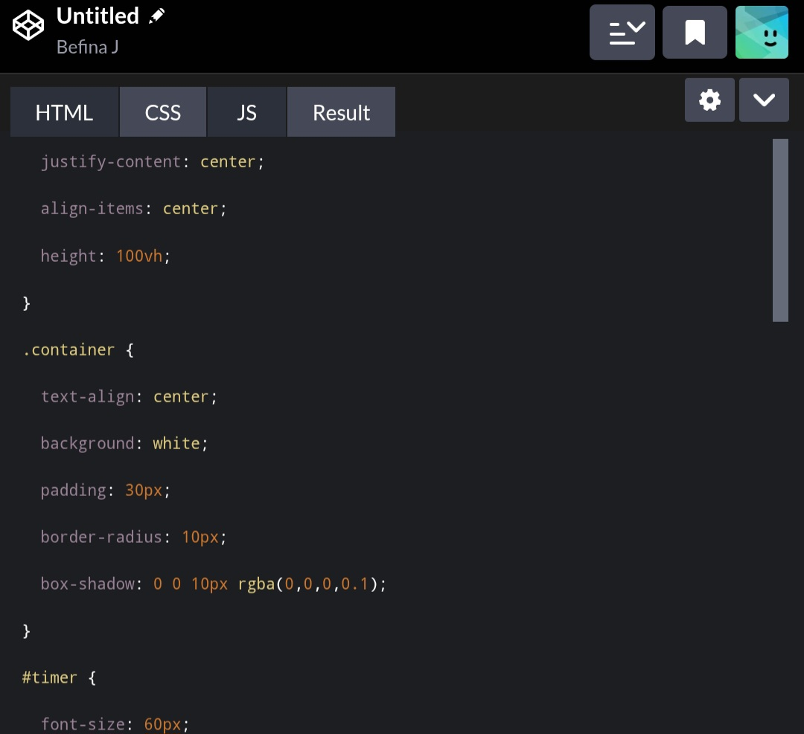
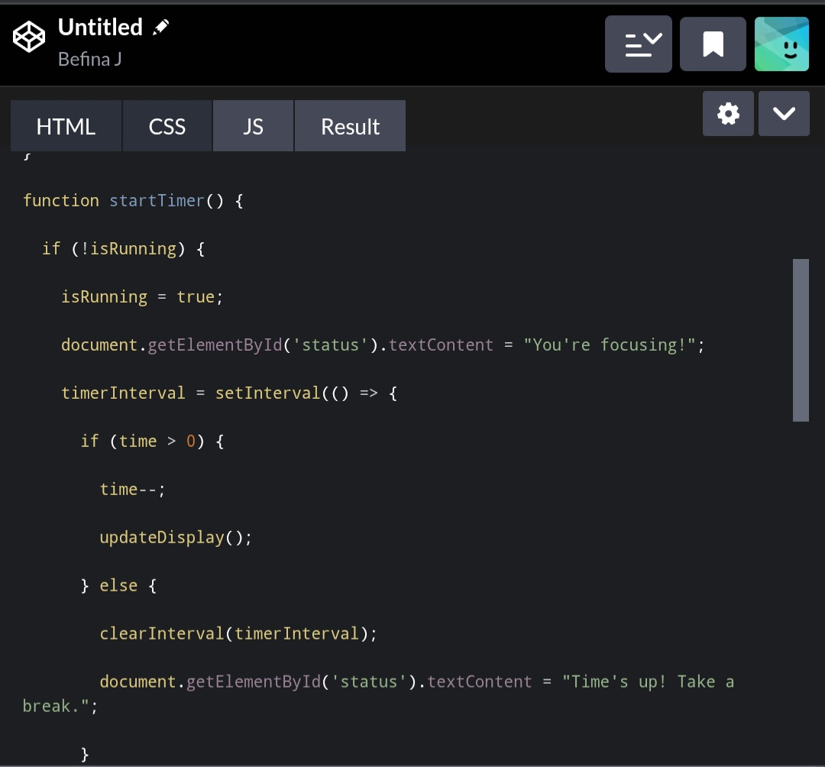
RESULTS AND SCREENSHOTS
3/21/2024 Annual Review
10

Slide 11
CONCLUSION
Focus Timer is a practical solution to a common productivity challenge. It demonstrates core web development skills and user-centered design. Future enhancements could include sound alerts, dark mode, and session tracking.
11

